Slide 1
Chapter 3
Describing Syntax and Semantics

Slide 2
Chapter 3 Topics
Introduction
The General Problem of Describing Syntax
Formal Methods of Describing Syntax
Attribute Grammars
Describing the Meanings of Programs: Dynamic Semantics
Copyright © 2017 Pearson Education, Ltd. All rights reserved.
1-<number>

Slide 3
Introduction
Syntax: the form or structure of the expressions, statements, and program units
Semantics: the meaning of the expressions, statements, and program units
Syntax and semantics provide a language’s definition
  Users of a language definition
    Other language designers
    Implementers
    Programmers (the users of the language)
Copyright © 2017 Pearson Education, Ltd. All rights reserved.
1-<number>

Slide 4
The General Problem of Describing Syntax: Terminology
A sentence is a string of characters over some alphabet
A language is a set of sentences
A lexeme is the lowest level syntactic unit of a language (e.g., *, sum, begin)
A token is a category of lexemes (e.g., identifier)
Copyright © 2017 Pearson Education, Ltd. All rights reserved.
1-<number>

Slide 5
The General Problem of Describing Syntax: Terminology
index = 2 * count + 17
LEXEMES | TOKENS
Index | Identifier
= | Equal sign
2 | Int_literal
* | Mult_op
Count | Identifier
+ | Plus_op
17 | Int_literal
; | semicolon
Copyright © 2017 Pearson Education, Ltd. All rights reserved.
1-<number>

Slide 6
Formal Definition of Languages
Languages can be formally defined in two distinct ways: by recognition and by generation
Recognizers
  A recognition device reads input strings over the alphabet of the language and decides whether the input strings belong to the language
  Example: syntax analysis part of a compiler
  the recognizer need not test all possible strings of characters from some set to determine whether each is in the language.
  it need only determine whether given programs are in the language.
  the syntax analyzer determines whether the given programs are syntactically correct.
Copyright © 2017 Pearson Education, Ltd. All rights reserved.
1-<number>

Slide 7
Formal Definition of Languages
Generators
  A device that generates sentences of a language
  One can determine if the syntax of a particular sentence is syntactically correct by comparing it to the structure of the generator
  We can think of the generator as having a button that produces a sentence of the language every time it is pushed.
  To determine the correct syntax of a particular statement using a compiler, the programmer can only submit a speculated version and note whether the compiler accepts it. (language recognizer → trial-and-error mode!)
  On the other hand, it is often possible to determine whether the syntax of a particular statement is correct by comparing it with the structure of the generator.
Copyright © 2017 Pearson Education, Ltd. All rights reserved.
1-<number>

Slide 8
BNF and Context-Free Grammars
(to describe the syntax of PLS)
Context-Free Grammars
  Developed by Noam Chomsky in the mid-1950s
  The forms of the tokens of PLs by ← regular grammars
  The syntax of whole PLs← context-free grammars
Backus-Naur Form (1959)
  Invented by John Backus to describe the syntax of Algol 58
  BNF is equivalent to context-free grammars
  natural notation for describing syntax
Copyright © 2017 Pearson Education, Ltd. All rights reserved.
1-<number>

Slide 9
REGULAR GRAMMARS
Noam Chomsky has divided grammar into four types
Type | Name
0 | Unrestricted Grammar
1 | Context Sensitive Grammar
2 | Context Free Grammar
3 | Regular Grammar
Copyright © 2017 Pearson Education, Ltd. All rights reserved.
1-<number>

Slide 10
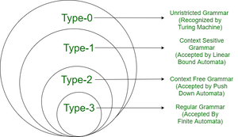
REGULAR GRAMMARS
Copyright © 2017 Pearson Education, Ltd. All rights reserved.
1-<number>

Slide 11
REGULAR GRAMMARS
A REGULAR GRAMMAR IS A CONTEXT-FREE GRAMMAR!
The language it generates is called Regular Language.
They are the most restricted form of grammar.
Copyright © 2017 Pearson Education, Ltd. All rights reserved.
1-<number>

Slide 12
regular expressions
Regular Expressions are capable of describing the syntax of Tokens. Any syntactic construct that can be described by Regular Expression can also be described by the Context free grammar.
Copyright © 2017 Pearson Education, Ltd. All rights reserved.
1-<number>

Slide 13
regular expressions
∑ → alphabet (inputs)
r → regular expression
L → language
* (asterisk) → any number of occurrence
+ → at least one
? → zero or one
| → or
Copyright © 2017 Pearson Education, Ltd. All rights reserved.
1-<number>

Slide 14
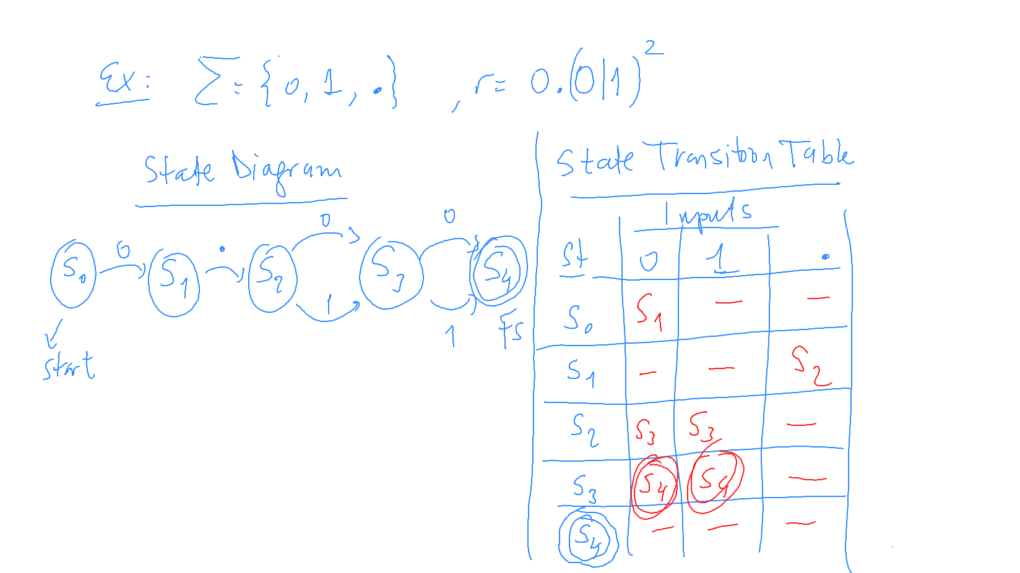
regular expressions
Copyright © 2017 Pearson Education, Ltd. All rights reserved.
1-<number>

Slide 15
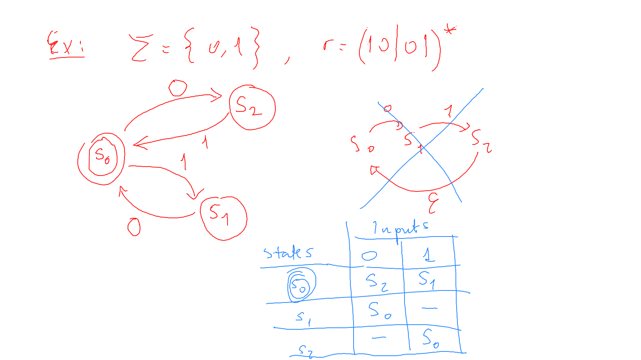
regular expressions
Copyright © 2017 Pearson Education, Ltd. All rights reserved.
1-<number>

Slide 16
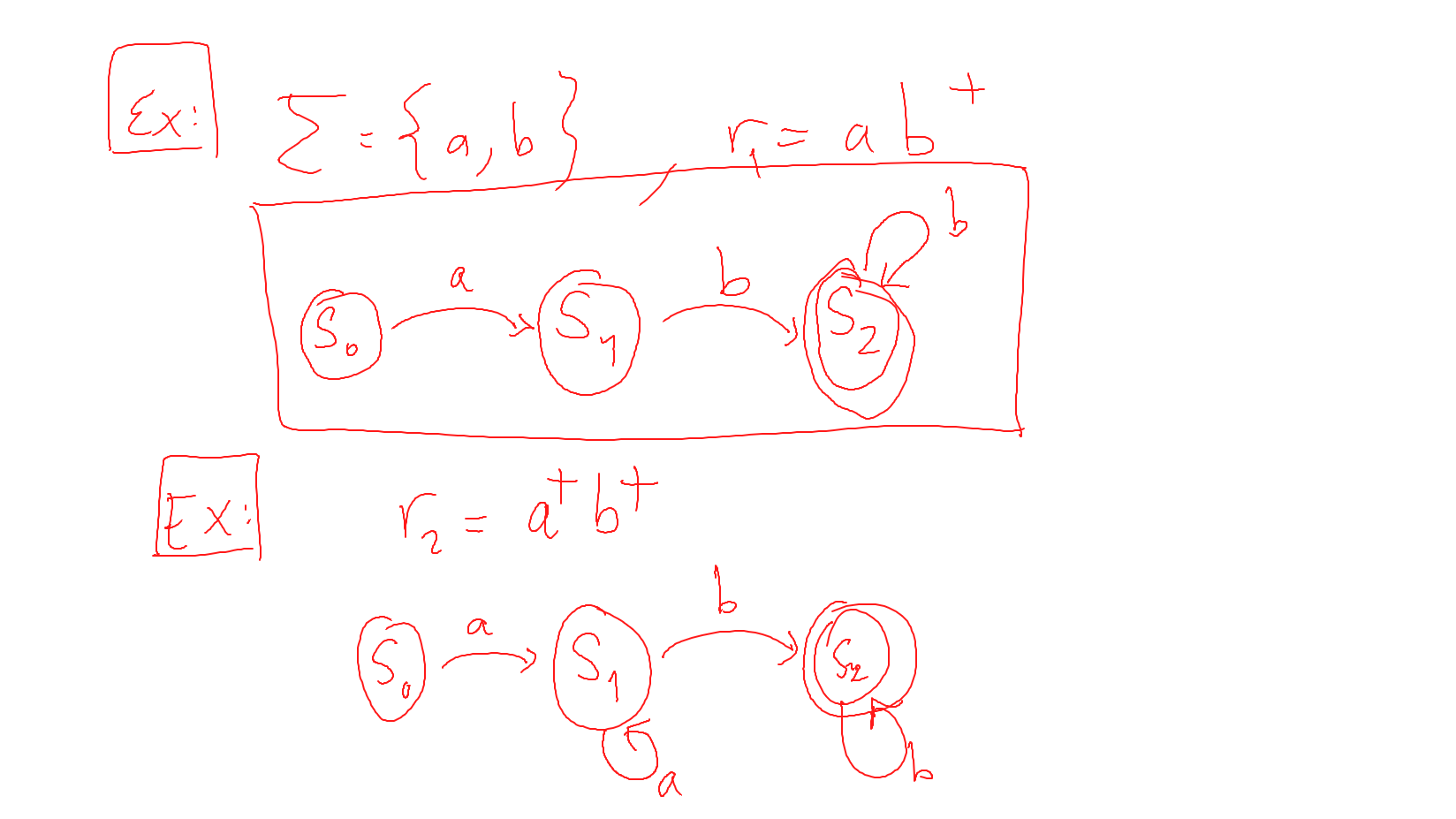
regular expressions
Copyright © 2017 Pearson Education, Ltd. All rights reserved.
1-<number>

Slide 17
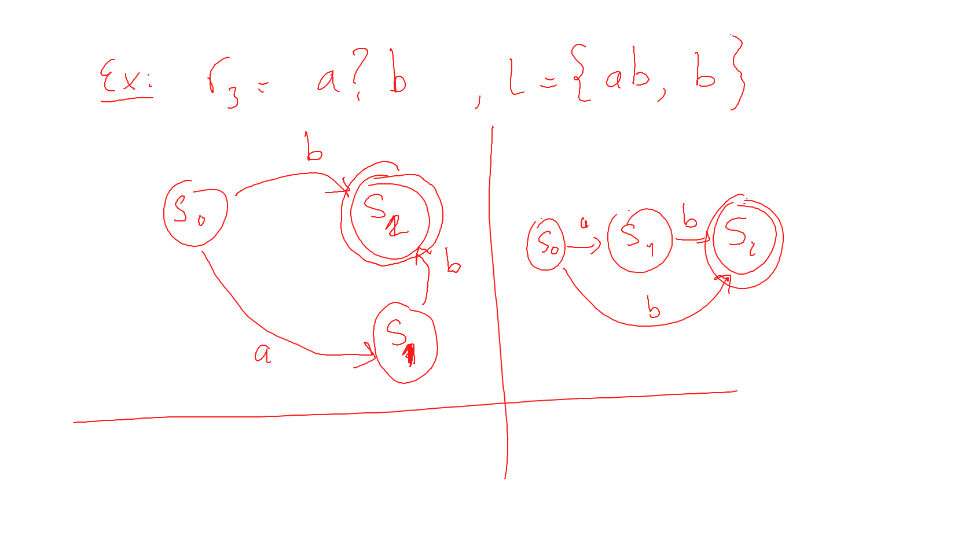
regular expressions
Copyright © 2017 Pearson Education, Ltd. All rights reserved.
1-<number>

Slide 18
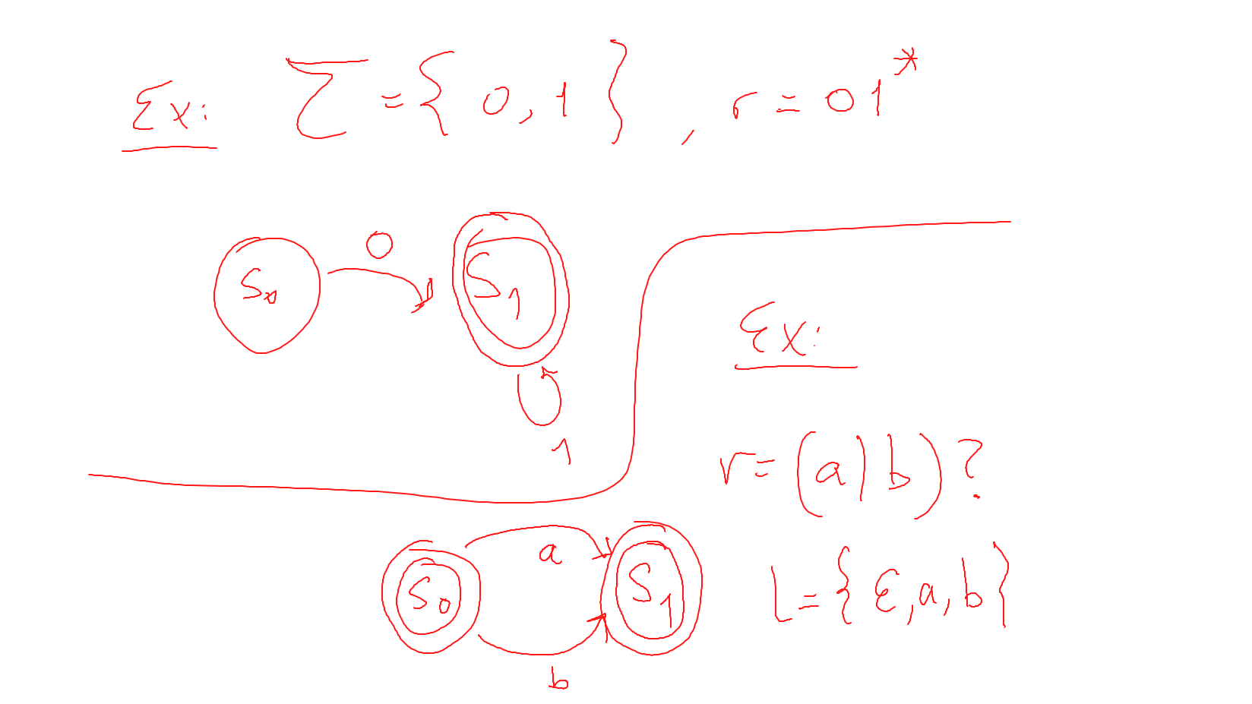
regular expressions
Copyright © 2017 Pearson Education, Ltd. All rights reserved.
1-<number>

Slide 19
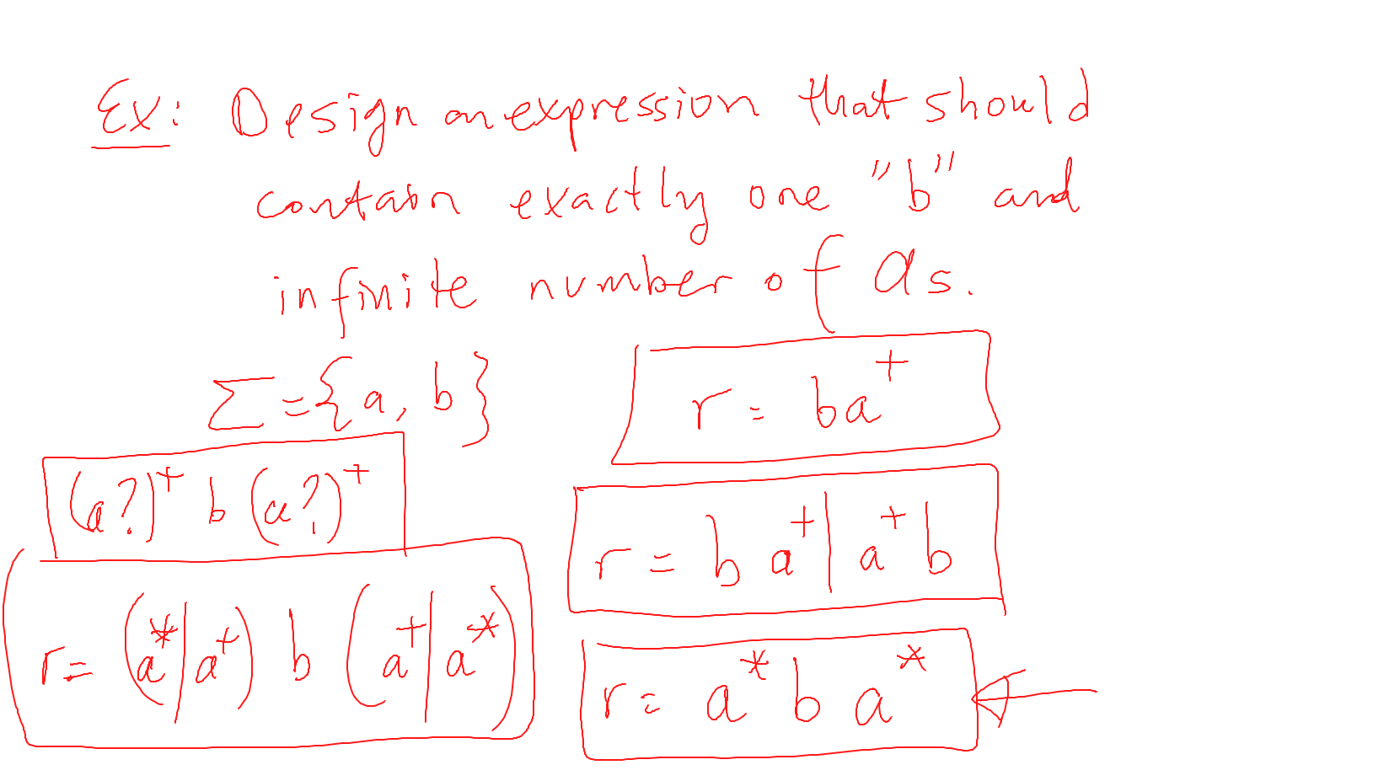
regular expressions
Copyright © 2017 Pearson Education, Ltd. All rights reserved.
1-<number>

Slide 20
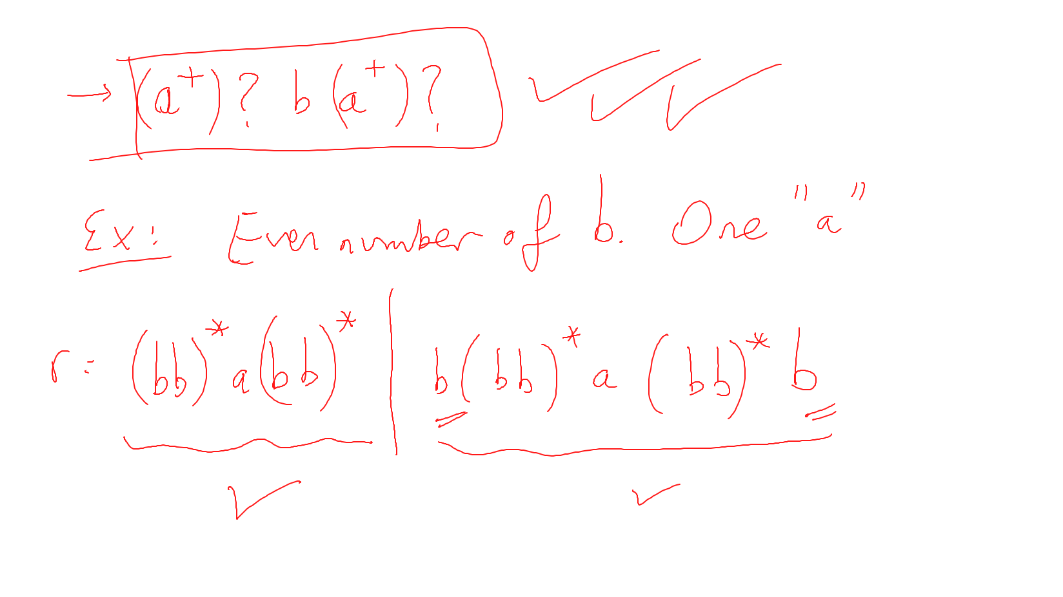
regular expressions
Legal? Valid? Neither statement alone is sufficient!
Copyright © 2017 Pearson Education, Ltd. All rights reserved.
1-<number>

Slide 21
REGULAR GRAMMARS – regular expressions - SUMMARY
A grammar is regular if it has rules of form
  A → a or
  A → aB or
  A → ɛ where ɛ is a special symbol called NULL (empty string).
A language is regular if it can be expressed in terms of regular expression.
A is a non-terminal (uppercase letters)
a is a terminal (lowercase letters)
Copyright © 2017 Pearson Education, Ltd. All rights reserved.
1-<number>

Slide 22
regular expressions - SUMMARY
Two regular expressions are equivalent if languages generated by them are same.
For example, (a|b*)* and (a|b)*
(ab)*ab and ab(ab)*
Copyright © 2017 Pearson Education, Ltd. All rights reserved.
1-<number>

Slide 23
BNF Fundamentals
A metalanguage → describe another language. BNF is a metalanguage for PLs.
In BNF, abstractions are used to represent classes of syntactic structures--they act like syntactic variables (also called nonterminal symbols, or just nonterminals)
Terminals are lexemes or tokens!
A rule has a left-hand side (LHS), which is a nonterminal, and a right-hand side (RHS), which is a string of terminals and/or non-terminals
RULE:
<assign> → <var> = <expression>
total=subtotal1 + subtotal2
Copyright © 2017 Pearson Education, Ltd. All rights reserved.
1-<number>

Slide 24
BNF Fundamentals (continued)
Nonterminals are often enclosed in angle brackets
  Examples of BNF rules:
  <ident_list> → identifier | identifier, <ident_list>
  <if_stmt> → if <logic_expr> then <stmt>
Grammar: a finite non-empty set of rules
A start symbol is a special element of the nonterminals of a grammar
Copyright © 2017 Pearson Education, Ltd. All rights reserved.
1-<number>

Slide 25
BNF Rules
An abstraction (or nonterminal symbol) can have more than one RHS
<stmt> → <single_stmt>
| begin <stmt_list> end
Vertical bar, logical OR
Copyright © 2017 Pearson Education, Ltd. All rights reserved.
1-<number>

Slide 26
BNF Rules a Java if statement can be described with the rules
<if_stmt> → if ( <logic_expr> ) <stmt>
<if_stmt> → if ( <logic_expr> ) <stmt> else <stmt>
  OR
<if_stmt> → if ( <logic_expr> ) <stmt>
| if ( <logic_expr> ) <stmt> else <stmt>
<stmt> represents either a single statement or a compound statement.
Copyright © 2017 Pearson Education, Ltd. All rights reserved.
1-<number>

Slide 27
Describing Lists
Syntactic lists are described using recursion
<ident_list> → ident
| ident, <ident_list>
A rule is recursive if its LHS appears in its RHS.
A derivation is a repeated application of rules, starting with the start symbol and ending with a sentence (all terminal symbols)
Copyright © 2017 Pearson Education, Ltd. All rights reserved.
1-<number>

Slide 28
An Example Grammar
<program> → <stmts>
<stmts> → <stmt> | <stmt> ; <stmts>
<stmt> → <var> = <expr>
<var> → a | b | c | d
<expr> → <term> + <term> | <term> - <term>
<term> → <var> | const
Copyright © 2017 Pearson Education, Ltd. All rights reserved.
1-<number>

Slide 29
An Example Derivation
<program> => <stmts> => <stmt>
=> <var> = <expr>
=> a = <expr>
=> a = <term> + <term>
=> a = <var> + <term>
=> a = b + <term>
=> a = b + const
Copyright © 2017 Pearson Education, Ltd. All rights reserved.
1-<number>

Slide 30
Derivations
Every string of symbols in a derivation is a sentential form
A sentence is a sentential form that has only terminal symbols
A leftmost derivation is one in which the leftmost nonterminal in each sentential form is the one that is expanded
A derivation may be rightmost or neither leftmost nor rightmost
Copyright © 2017 Pearson Education, Ltd. All rights reserved.
1-<number>

Slide 31
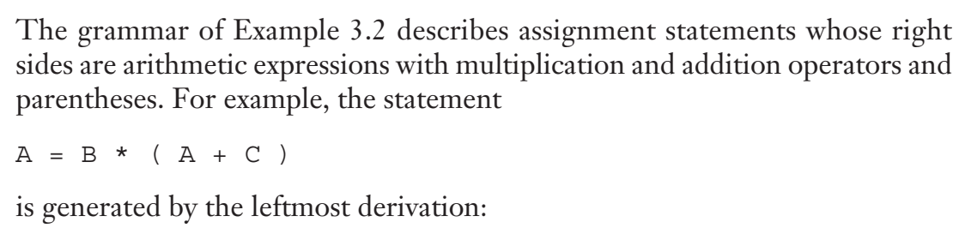
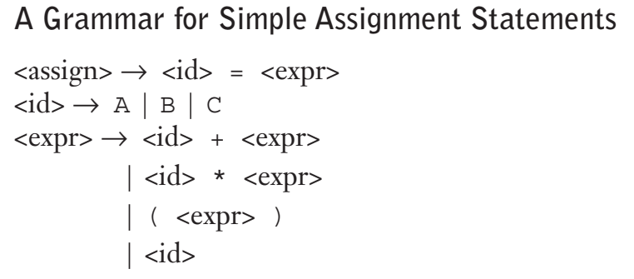
Derivations (leftmost)
Copyright © 2017 Pearson Education, Ltd. All rights reserved.
1-<number>

Slide 32
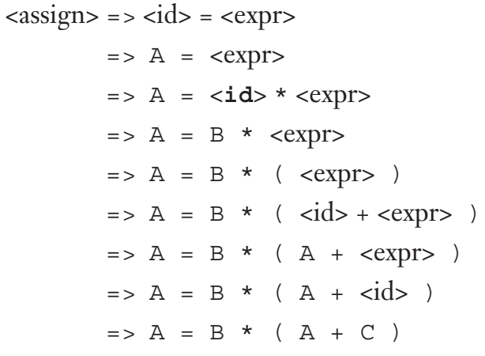
Derivations (leftmost)
Copyright © 2017 Pearson Education, Ltd. All rights reserved.
1-<number>

Slide 33
Parse Tree
A hierarchical representation of a derivation
<program>
<stmts>
<stmt>
<var>
=
<expr>
a
<term>
+
<term>
<var>
const
b
Copyright © 2017 Pearson Education, Ltd. All rights reserved.
1-<number>

Slide 34
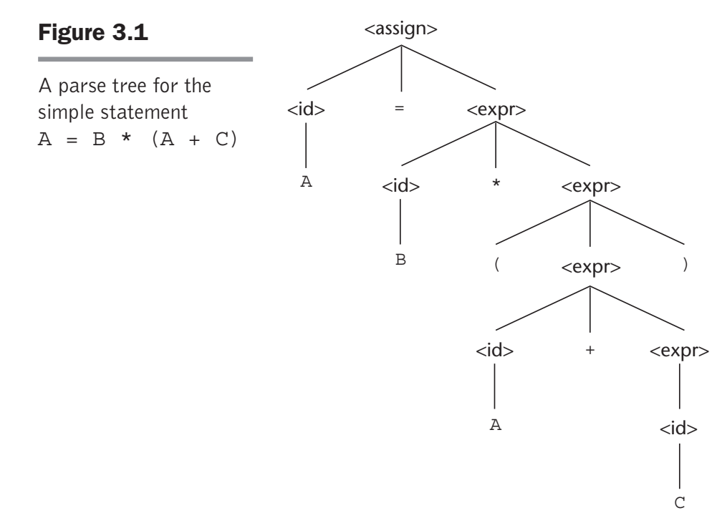
Parse Tree
Every internal node of a parse tree is labeled with a nonterminal symbol;
Every leaf is labeled with a terminal symbol.
Every subtree of a parse tree
describes one instance of an abstraction in the sentence.

Slide 35
Ambiguity in Grammars
A grammar is ambiguous if and only if it generates a sentential form that has two or more distinct parse trees
Copyright © 2017 Pearson Education, Ltd. All rights reserved.
1-<number>

Slide 36
An Ambiguous Expression Grammar
<expr> → <expr> <op> <expr> | const
<op> → / | -
<expr>
<expr>
<expr>
<op>
<expr>
<expr>
<op>
<op>
<expr>
<expr>
<op>
<expr>
<expr>
<op>
<expr>
const
-
const
/
const
const
-
const
/
const
Copyright © 2017 Pearson Education, Ltd. All rights reserved.
1-<number>

Slide 37
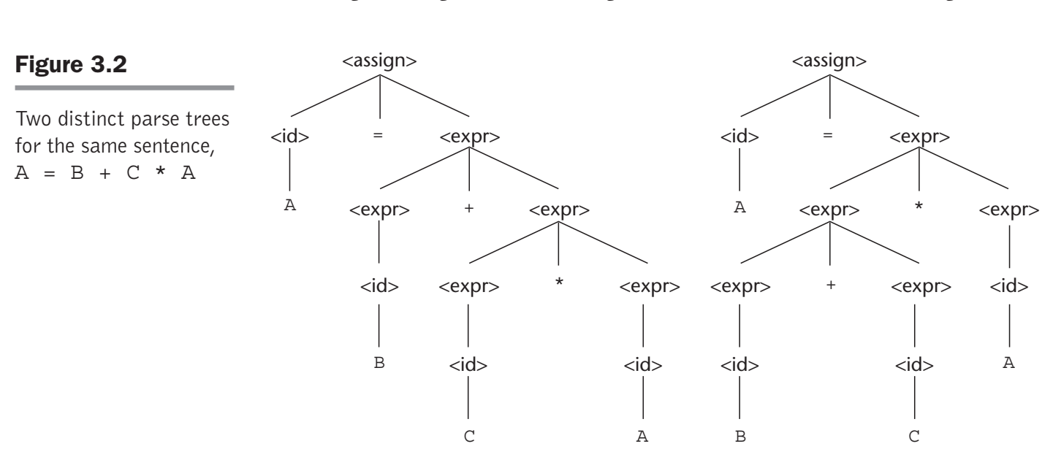
An Ambiguous Expression Grammar
Copyright © 2017 Pearson Education, Ltd. All rights reserved.
1-<number>

Slide 38
An Unambiguous Expression Grammar
If we use the parse tree to indicate precedence levels of the operators, we cannot have ambiguity
<expr> → <expr> - <term> | <term>
<term> → <term> / const | const
<expr>
<expr>
-
<term>
<term>
<term>
/
const
const
const
Copyright © 2017 Pearson Education, Ltd. All rights reserved.
1-<number>

Slide 39
Associativity of Operators
When an expression includes two operators that have the same precedence (as * and / usually have), a semantic rule is required to specify which should have precedence. → This rule is named ASSOCIATIVITY!
Copyright © 2017 Pearson Education, Ltd. All rights reserved.
1-<number>

Slide 40
Associativity of Operators
Operator associativity can also be indicated by a grammar
<expr> -> <expr> + <expr> | const (ambiguous)
<expr> -> <expr> + const | const (unambiguous)
<expr>
<expr>
B+C+A
<expr>
+
const
<expr>
+
const
const
Copyright © 2017 Pearson Education, Ltd. All rights reserved.
1-<number>

Slide 41
Unambiguous Grammar for Selector
ADA if-then-else grammar
<if_stmt> -> if <logic_expr> then <stmt>
| if <logic_expr> then <stmt> else <stmt>
If we also have <stmt> → <if_stmt> grammar Ambiguous!
- An unambiguous grammar for if-then-else
<stmt> -> <matched> | <unmatched>
<matched> -> if <logic_expr> then <matched> else <matched>
| any non-if statement
<unmatched> -> if <logic_expr> then <stmt>
| if <logic_expr> then <matched> else
<unmatched>
1-<number>

Slide 42
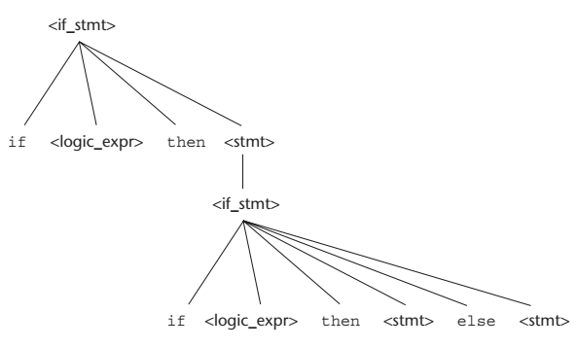
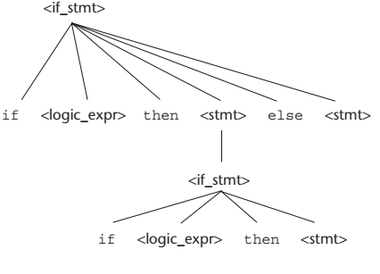
Unambiguous Grammar for Selector
Two distinct parse trees for the same sentential form
there cannot be an if statement without an else between a then and its matching else.
if <logic_expr> then if <logic_expr> then <stmt> else <stmt>
Copyright © 2017 Pearson Education, Ltd. All rights reserved.
1-<number>

Slide 43
Unambiguous Grammar for Selector
- An unambiguous grammar for if-then-else
<stmt> -> <matched> | <unmatched>
<matched> -> if <logic_expr> then <matched> else <matched>
| any non-if statement
<unmatched> -> if <logic_expr> then <stmt>
| if <logic_expr> then <matched> else
<unmatched>
unmatched statements are else-less ifs
if <logic_expr> then if <logic_expr> then <stmt> else <stmt>
  There is just one possible parse tree!
1-<number>

Slide 44
Extended BNF The extensions do not enhance the descriptive power of BNF; they only increase its readability and writability.
Optional parts are placed in brackets [ ]
<proc_call> → ident [(<expr_list>)]
Alternative parts of RHSs are placed inside parentheses and separated via vertical bars
<term> → <term> (+|-) const
Repetitions (0 or more) are placed inside braces { }
<ident> → letter {letter|digit}
Copyright © 2017 Pearson Education, Ltd. All rights reserved.
1-<number>

Slide 45
BNF and EBNF
BNF
<expr> → <expr> + <term>
| <expr> - <term>
| <term>
<term> → <term> * <factor>
| <term> / <factor>
| <factor>
EBNF
<expr> → <term> {(+ | -) <term>}
<term> → <factor> {(* | /) <factor>}
Copyright © 2017 Pearson Education, Ltd. All rights reserved.
1-<number>

Slide 46
Recent Variations in EBNF
Alternative RHSs are put on separate lines
Use of a colon instead of “→”
Use of _{opt} for optional parts
Use of oneof for choices
Copyright © 2017 Pearson Education, Ltd. All rights reserved.
1-<number>

Slide 47
Static Semantics
Context-free grammars (CFGs) cannot describe all of the syntax of programming languages
Ex:
You cannot define types of operands in expressions
You cannot dictate that variables must be declared before they are used
Copyright © 2017 Pearson Education, Ltd. All rights reserved.
1-<number>

Slide 48
Attribute Grammars
Attribute grammars (AGs) have additions to CFGs to carry some semantic info on parse tree nodes
Many static semantic rules of a language state its type constraints.
Static semantics is so named because the analysis required to check these specifications can be done at compile time.
Copyright © 2017 Pearson Education, Ltd. All rights reserved.
1-<number>

Slide 49
Attribute Grammars (example)
the name on the end of an Ada procedure must match the procedure’s name.
This rule cannot be stated in BNF!
Syntax rule: <proc_def> → procedure <proc_name>[1]
<proc_body> end <proc_name>[2];
Predicate: <proc_name>[1].string == <proc_name>[2].string
the predicate rule states that the name string attribute of the <proc_name> nonterminal in the subprogram header must match the name string attribute of the <proc_name> nonterminal following the end of the subprogram.
Copyright © 2017 Pearson Education, Ltd. All rights reserved.
1-<number>

Slide 50
Attribute Grammars (example)
the name on the end of an Ada procedure must match the procedure’s name.
This rule cannot be stated in BNF!
Syntax rule: <proc_def> → procedure <proc_name>[1]
<proc_body> end <proc_name>[2];
Predicate: <proc_name>[1].string == <proc_name>[2].string
procedure A_Test (A, B: in Integer; C: out Integer) is
begin
C := A + B;
end A_Test;
Copyright © 2017 Pearson Education, Ltd. All rights reserved.
1-<number>

Slide 51
Attribute Grammars (example)
Notice that when there is more than one occurrence of a nonterminal in a syntax rule in an attribute grammar, the nonterminals are subscripted with brackets to distinguish them.
<proc_name>[1].string == <proc_name>[2].string
Copyright © 2017 Pearson Education, Ltd. All rights reserved.
1-<number>

Slide 52
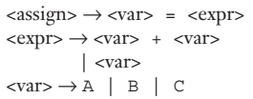
Attribute Grammars (example 2)
A = A + B
The variables can be one of two types: int or real.
When there are two variables on the right side of an assignment, they need not be the same type.
The type of the expression when the operand types are not the same is always real.
The type of the left side of the assignment must match the type of the right side.
So the types of operands in the right side can be mixed, but the assignment is valid only if the target and the value resulting from evaluating the right side have the same type.
Copyright © 2017 Pearson Education, Ltd. All rights reserved.
1-<number>

Slide 53
Attribute Grammars (example 2)
The attributes for the nonterminals in the example attribute grammar:
actual_type — A synthesized attribute associated with the nonterminals <var>
and <expr>. It is used to store the actual type, int or real, of a variable or expression.
expected_type—An inherited attribute associated with the nonterminal
<expr>. It is used to store the type, either int or real, that is expected for
the expression, as determined by the type of the variable on the left side of
the assignment statement.
Copyright © 2017 Pearson Education, Ltd. All rights reserved.
1-<number>

Slide 54
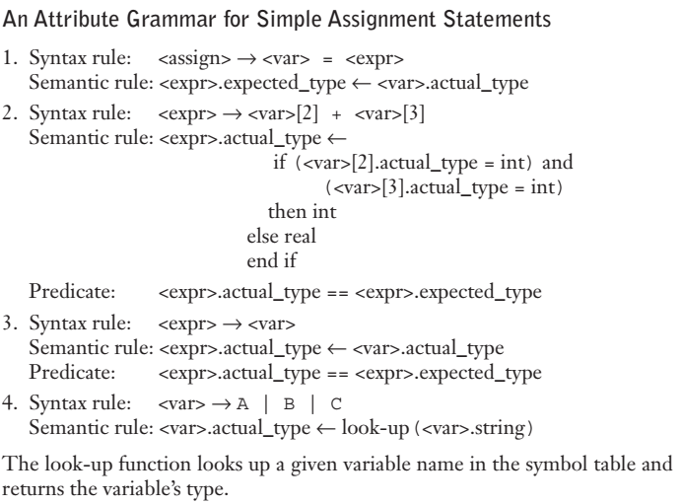
Attribute Grammars (example 2)
Copyright © 2017 Pearson Education, Ltd. All rights reserved.
1-<number>

Slide 55
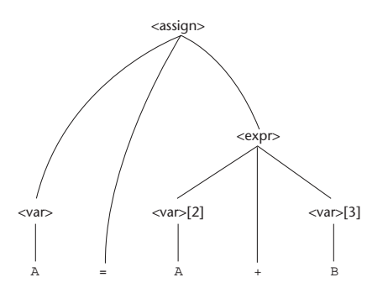
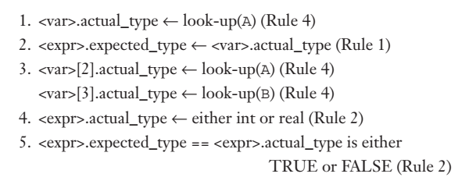
Attribute Grammars (example 2)
A=A+B
Copyright © 2017 Pearson Education, Ltd. All rights reserved.
1-<number>

Slide 56

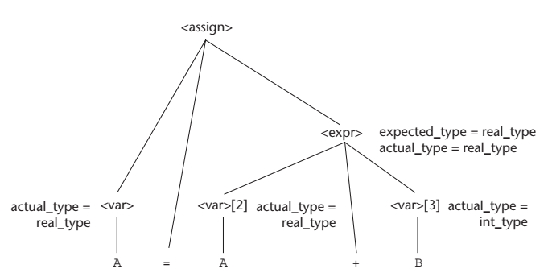
Attribute Grammars (example 2)
A=A+B
real
int
Copyright © 2017 Pearson Education, Ltd. All rights reserved.
1-<number>

Slide 57
Summary
BNF and context-free grammars are equivalent meta-languages
  Well-suited for describing the syntax of programming languages
An attribute grammar is a descriptive formalism that can describe both the syntax and the semantics of a language
Three primary methods of semantics description
  Operation, axiomatic, denotational
Copyright © 2017 Pearson Education, Ltd. All rights reserved.
1-<number>

